Slide 1
Graphs

Slide 2


Graph
Graph is a generalization of the tree
Node can be connected to each other in any manner
There is no root, parent or child node
Graph can have a loop, whereas tree does not have a loop

Slide 3
Graph Definitions
A graph G is denoted by G = (V, E) where
  V is the set of vertices or nodes of the graph
  E is the set of edges or arcs connecting the vertices in V
Each edge E is denoted as a pair (v,w) where v,w ε V
For example in the graph below
2
V = {1, 2, 3, 4, 5, 6}
E = {(1, 2) (2,1) (2, 5) (5,2) (3, 6) (6,3) (4, 6) (6,4) (5, 6) (6,5)}
1
3
6
4
5

Slide 4
Graph Definitions (contd.)
If the pair of vertices is ordered then the graph is a directed graph or a di-graph
2
1
3
Here,
V = {1, 2, 3, 4, 5, 6}
E = {(1, 2) (2, 5) (5, 6) (6, 3) (6, 4)}
6
4
5
Vertex v is adjacent to w if (v,w) ε E
Sometimes an edge has another component called a weight or cost. If the weight is absent it is assumed to be 1

Slide 5
Graph Definitions (contd.)
2
4
1
3
1
2.5
6
4
2
1.2
5
Here,
V = {1, 2, 3, 4, 5, 6}
E = {(1, 2,4) (2, 5,1) (5, 6,1.2) (6, 3,2.5) (6, 4,2)}

Slide 6
Applications of Graphs
Driving Map
  Edge = Road
  Vertex = Intersection
  Edge weight = Time required to cover the road
Airline Traffic
  Vertex = Cities serviced by the airline
  Edge = Flight exists between two cities
  Edge weight = Flight time or flight cost or both
Computer networks
  Vertex = Server/router nodes
  Edge = Data link
  Edge weight = Connection speed

Slide 7


Slide 8
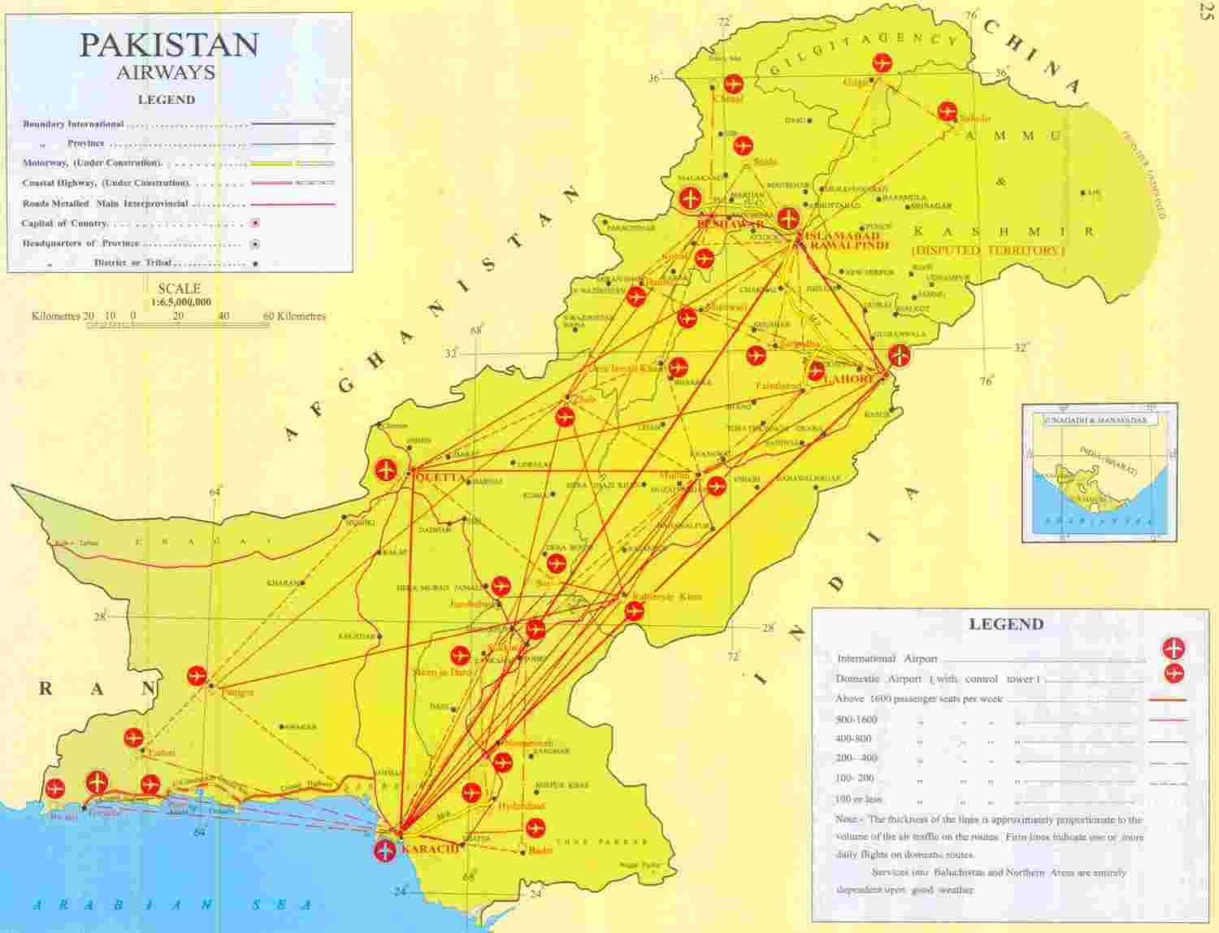

Slide 9
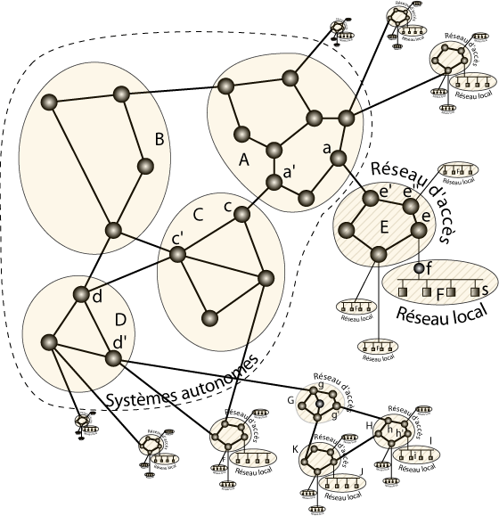
Part of an Internet

Slide 10
Representing Graphs: Adjacency Matrix
Two dimensional matrix A of size n x n where n is the number of vertices in the graph
  a[i, j] = 0 if there is no edge between vertices i and j
  a[i, j] = 1 if there is an edge between vertices i and j
  Undirected graphs have both a[i, j] and a[j, i] = 1 if there is an edge between vertices i and j
  a[i, j] = weight for weighted graphs
Space requirement is N²
Problem: The array is very sparsely populated. For example if a directed graph has 4 vertices and 3 edges, then adjacency matrix has 16 cells, only 3 of which are 1

Slide 11
Example
0 1 2 3 4
0
1
2
3
4
0 | 1 | 0 | 0 | 1
1 | 0 | 1 | 1 | 1
0 | 1 | 0 | 1 | 0
0 | 1 | 1 | 0 | 1
1 | 1 | 0 | 1 | 0
0
1
2
4
3

Slide 12
Representing Graphs: Adjacency List
Adjacency List
  Array of lists
  Each vertex has an array entry
  A vertex w is inserted in the list for vertex v if there is an outgoing edge from v to w
  Space requirement is V+E

Slide 13
Adjacency List Example
2
1
2
3
4
5
6
2
1
3
5
6
4
6
5
3
4
Graph
Adjacency List
An adjacency list for a weighted graph should contain two elements in the list nodes – one element for the vertex and the second element for the weight of that edge

